Slide 1


Terratech: An Integrated IoT and Robotics-Driven System for
Precision Agricultural Monitoring and Sustainable Crop Production
Project synopsis submitted in partial fulfillment for the degree of
Bachelor of Technology in Electronics and Communications Engineering
of
Maulana Abul Kalam Azad University of Technology (formerly known as West Bengal
University of Technology)
By
SOUMYADIP BERA (MAKAUT Roll No :14800321021)
DEBARUN DAS (MAKAUT Roll No :14800321015)
NIKITA TIWARI (MAKAUT Roll No :14800322085)
&
DIYA DAS (MAKAUT Roll No :14800321017)
Under the supervision of
Prof.(Dr.) SUMEDHA DASGUPTA
(Assistant Professor, Dept of ECE, FIEM)
Department of Electronics & Communications Engineering
Future Institute of Engineering & Management
Sonarpur Station Road, Kolkata-700150
2025

Slide 2
INTRODUCTION
This project proposes an IoT-based Agricultural Monitoring and Surveillance System to transform farming methods using sensors, Arduino technology, IoT architecture, and cloud-based analysis.
The system enables real-time monitoring of crop health and environmental conditions to facilitate timely and informed decisions.
The system comprises soil moisture, temperature, and humidity sensors and high-definition cameras for visual crop observation.
The data from sensors and cameras is sent wirelessly to a cloud platform, and farmers can monitor and control their fields remotely using smartphones or computers.
This real-time monitoring system facilitates precision agriculture with improved efficiency of resource utilization, improved crop productivity, and reduced labor.
Unlike conventional monitoring systems, the system presented is a cost-efficient, real-time, and user-centered system that is adaptable and versatile enough to implement in a range of agricultural environments.
The system overcomes issues like high costs of implementation, inaccuracy of data, and technological barriers among small-scale farmers.
By such measures, the system equips farmers with actionable information, thereby improving their ability to react to changing environmental conditions in a timely manner.

Slide 3
LITERATURE SURVEY
Automation and Robotics:
Shamshiri et al. (2018) [11] note that digital farming holds promise through technologies such as data analysis, robots, and sensors to move towards a departure from conventional farming practice.
Zhu et al. (2023) [15] designed an autonomous robot, AROS, for orchard mapping, illustrating the capability of mobile robotic platforms to automate the acquisition of spatial and visual information.
Khosravani et al. (2023) [7] discussed the prediction of forces in seeding systems via semi-analytical and discrete element methods to enhance the accuracy of agriculture operations.
Smart Farming and Internet of Things (IoT):
Dhanaraju et al. (2022) [4] present an overview of IoT-based sustainable agriculture, describing how the combination of IT, IoT, and cloud computing can transform farming practices.
Raghuvanshi et al. (2021) [9] highlight that IoT technology increases the capability of automation systems in agriculture and facilitates the creation of smart farming devices.
Gondchawar & Kawitkar (2016) [5] and Rao & Sridhar (2018) [10] also explain IoT-based smart agriculture systems.
This information can be utilized to optimize irrigation, fertilization, and other inputs, resulting in enhanced crop production and resource use efficiency (JETIR, 2021) [6]; Sushant & Sujatha, 2018 [12]).
Further, Lin et al. (2018) [8] investigate blockchain and IoT-based food traceability in smart agricultural systems to meet the increasing demand for food safety and supply chain openness.
Bekmirzaev et al. (2019) [1] investigated the influence of various irrigation water regimes on Tetragonal Tetragonioides and showed how careful water management can affect crop development and yield.
Wang et al. (2021) [14] assessed the influence of cumulative temperature and rainfall on maize yield and disease, emphasizing the role of environmental data in crop management.
Boniecki et al. (2020) [2] further examined the application of neural visual detection of grain weevil, demonstrating how technology can be utilized to guard stored crops.

Slide 4
LITERATURE SURVEY(Cntd)
Applications of Machine Learning in Agriculture:
Trader et al. (2023) [13] created a machine learning model to aid in the decision of irrigating apple trees based on parameters such as precipitation, erosion, and water balance.
Boniecki et al. (2020) [2] applied neural networks to visually detect grain weevil, illustrating the use of machine learning in crop protection.
Challenges and Considerations:
Bradley (2003) [3] describes the necessity for user acceptance of new technology and states that companies might invest in technology and later discover that their users are resistant to it
Shamshiri et al. (2018) [11] indicate that the economic advantage of greater efficiency may presently lie with technology providers rather than with agricultural producers.

Slide 5
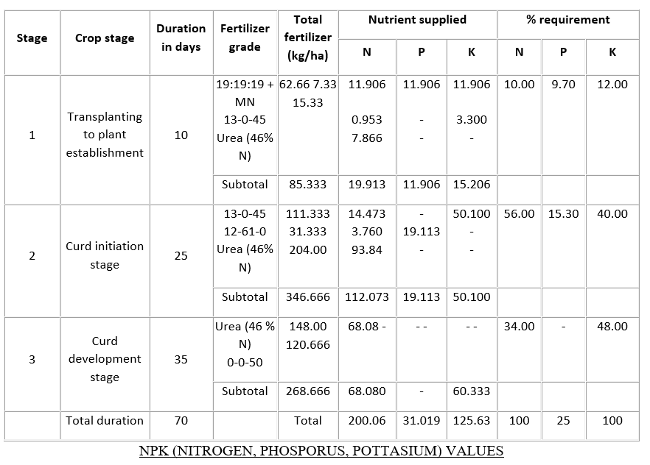
NPK(NITROGEN, PHOSPHORUS,POTASSIUM) DATASHEET
NPK DATA SHEET
75% of RD of P applied as superphosphate = 586 kg/ha
1.19: 19: 19+MN = 63 kg
2.13: 0: 45 = 119 kg
3.Urea = 368 kg
4.0-0-50 = 121 kg
5.12:61:0 = 32 kg

Slide 6
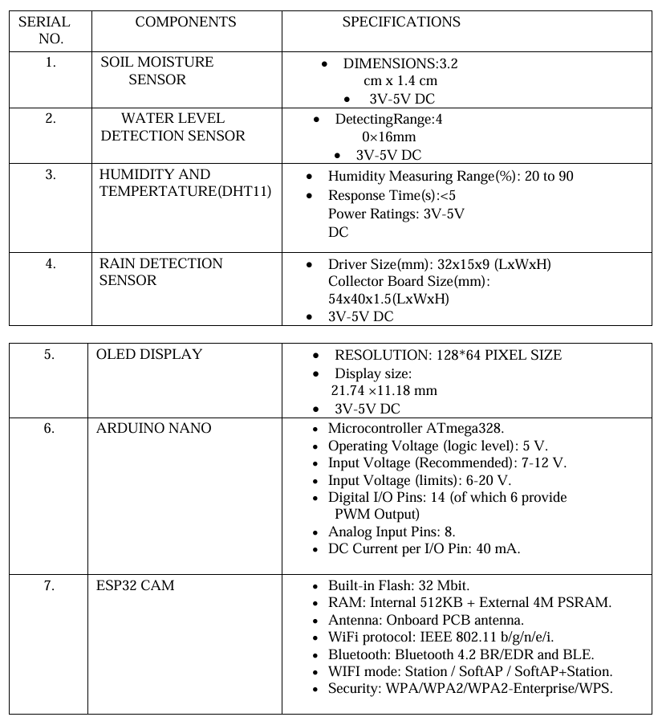
COMPONENTS USED

Slide 7
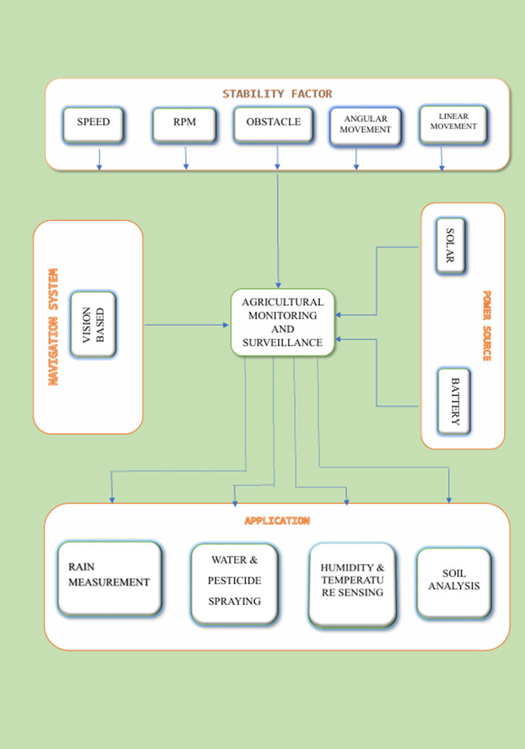
BLOCK DIAGRAM OF ROVER
Fig: Dual-mode Robotic Car used control in agricultural field operations.

Slide 8
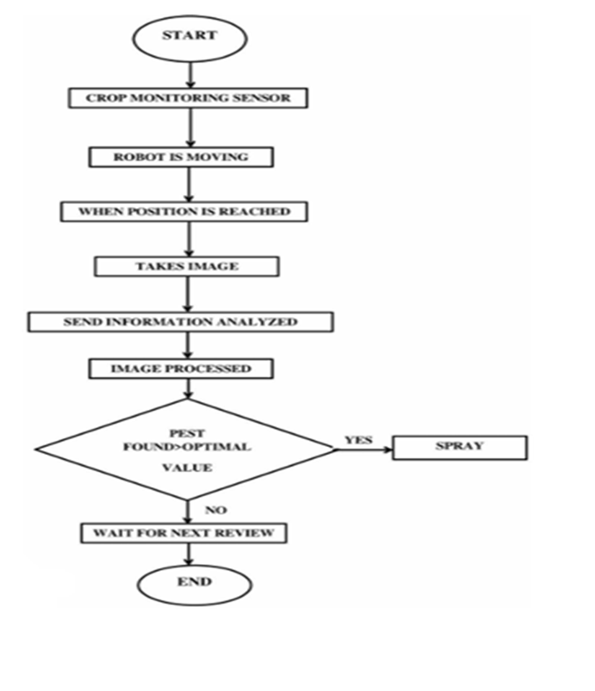
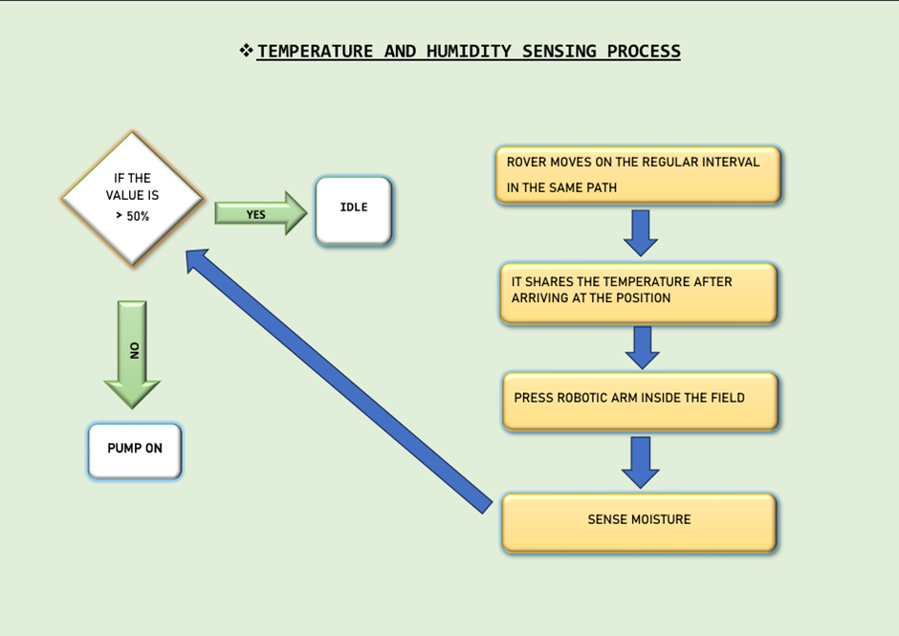
Flowchart of Temperature &
Humidity Sensing Process:
Flow Chart Demonstrates Working of Agri-bot:

Slide 9
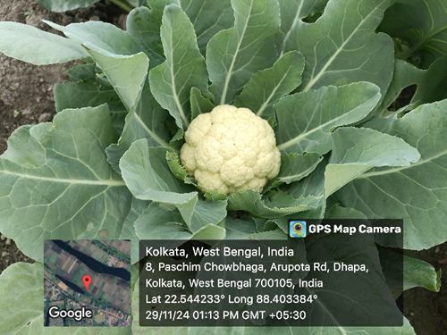
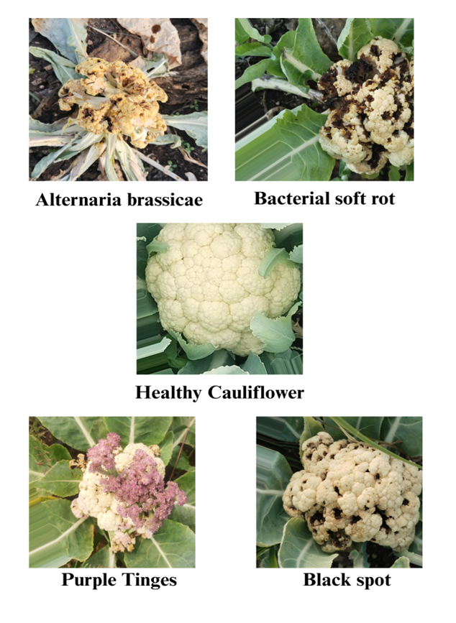
METHODOLOGY(Cntd)
Problem Identification and Gap Analysis
Terratech addresses this gap by deploying lightweight artificial intelligence on an edge computing platform, thereby offering a practical and economical approach to precision farming.
System Overview
The implementation employs an ESP32-CAM module for live image acquisition, Edge Impulse for dataset-driven model training, and Python along with OpenCV for supplementary image processing and visualization.
Dataset Preparation/Cauliflower Type Classification Using Machine Learning
Fig:Representative Images of Cauliflower
Stages/Conditions used for Model Training/Validation
Fig: Types of cauliflower used in our dataset

Slide 10
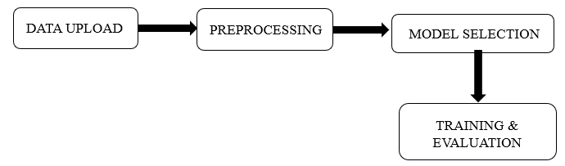
METHODOLOGY(Cntd)
Model Training with Edge Impulse
Deployment of Model on ESP32-CAM

Slide 11
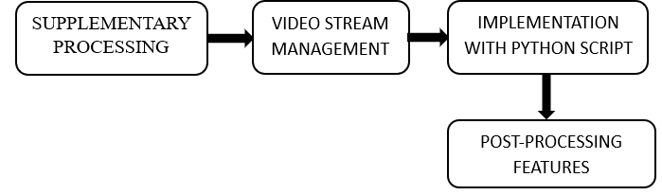
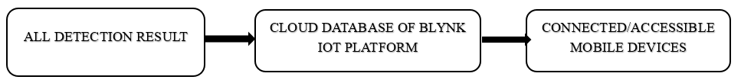
METHODOLOGY(Cntd)
Real-Time Processing Using OpenCV and Python
Transmission of Data and Alert Mechanism

Slide 12
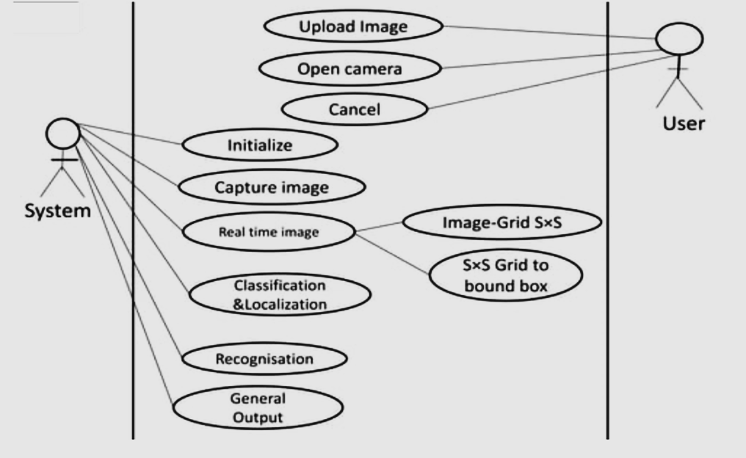
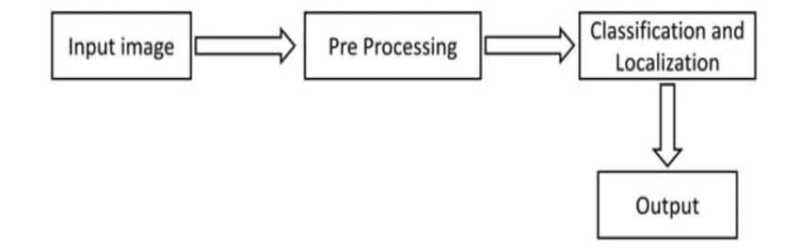
BLOCK DIAGRAM OF CROP HEALTH
MONITORING SYSTEM
FLOW CHART FOR IMAGE PROCESSING
This diagram is a use case diagram for an image classification and localization system, illustrating interactions between a user and a system.

Slide 13
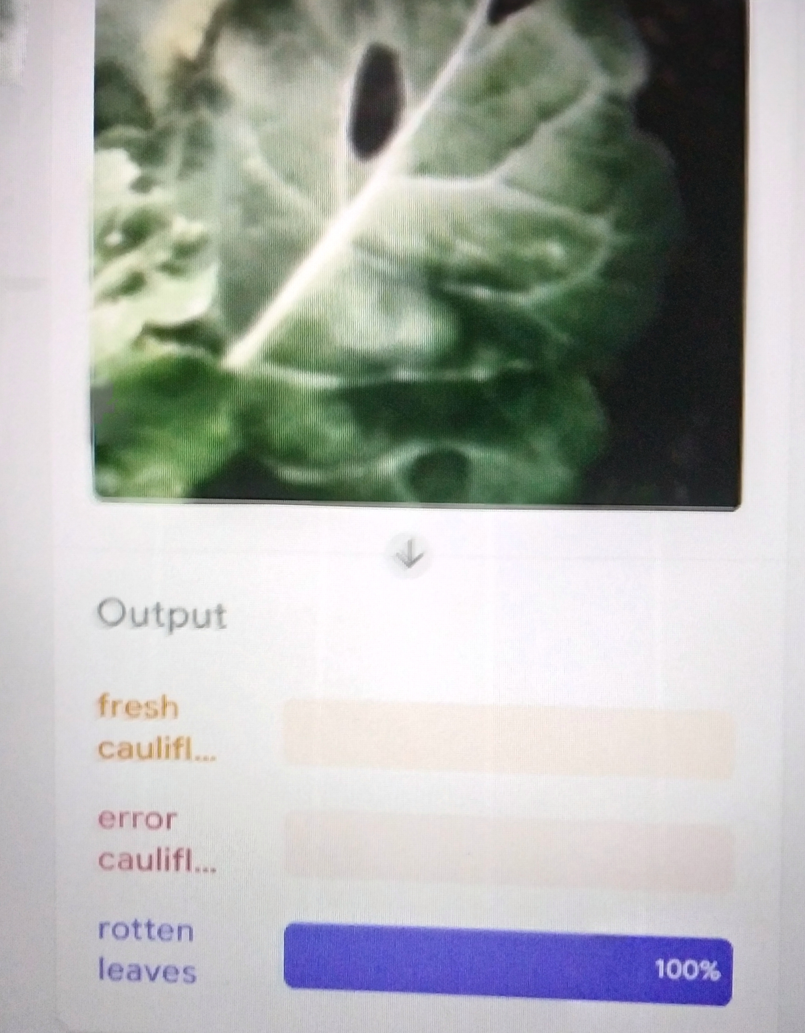
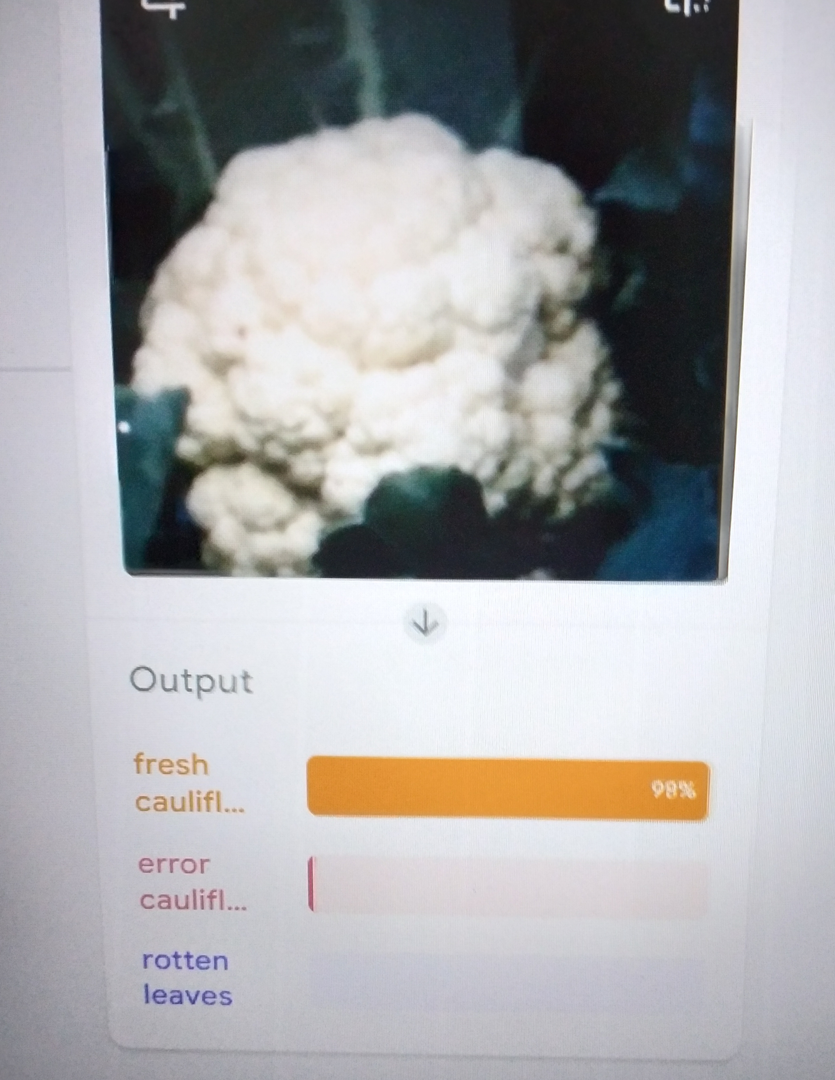
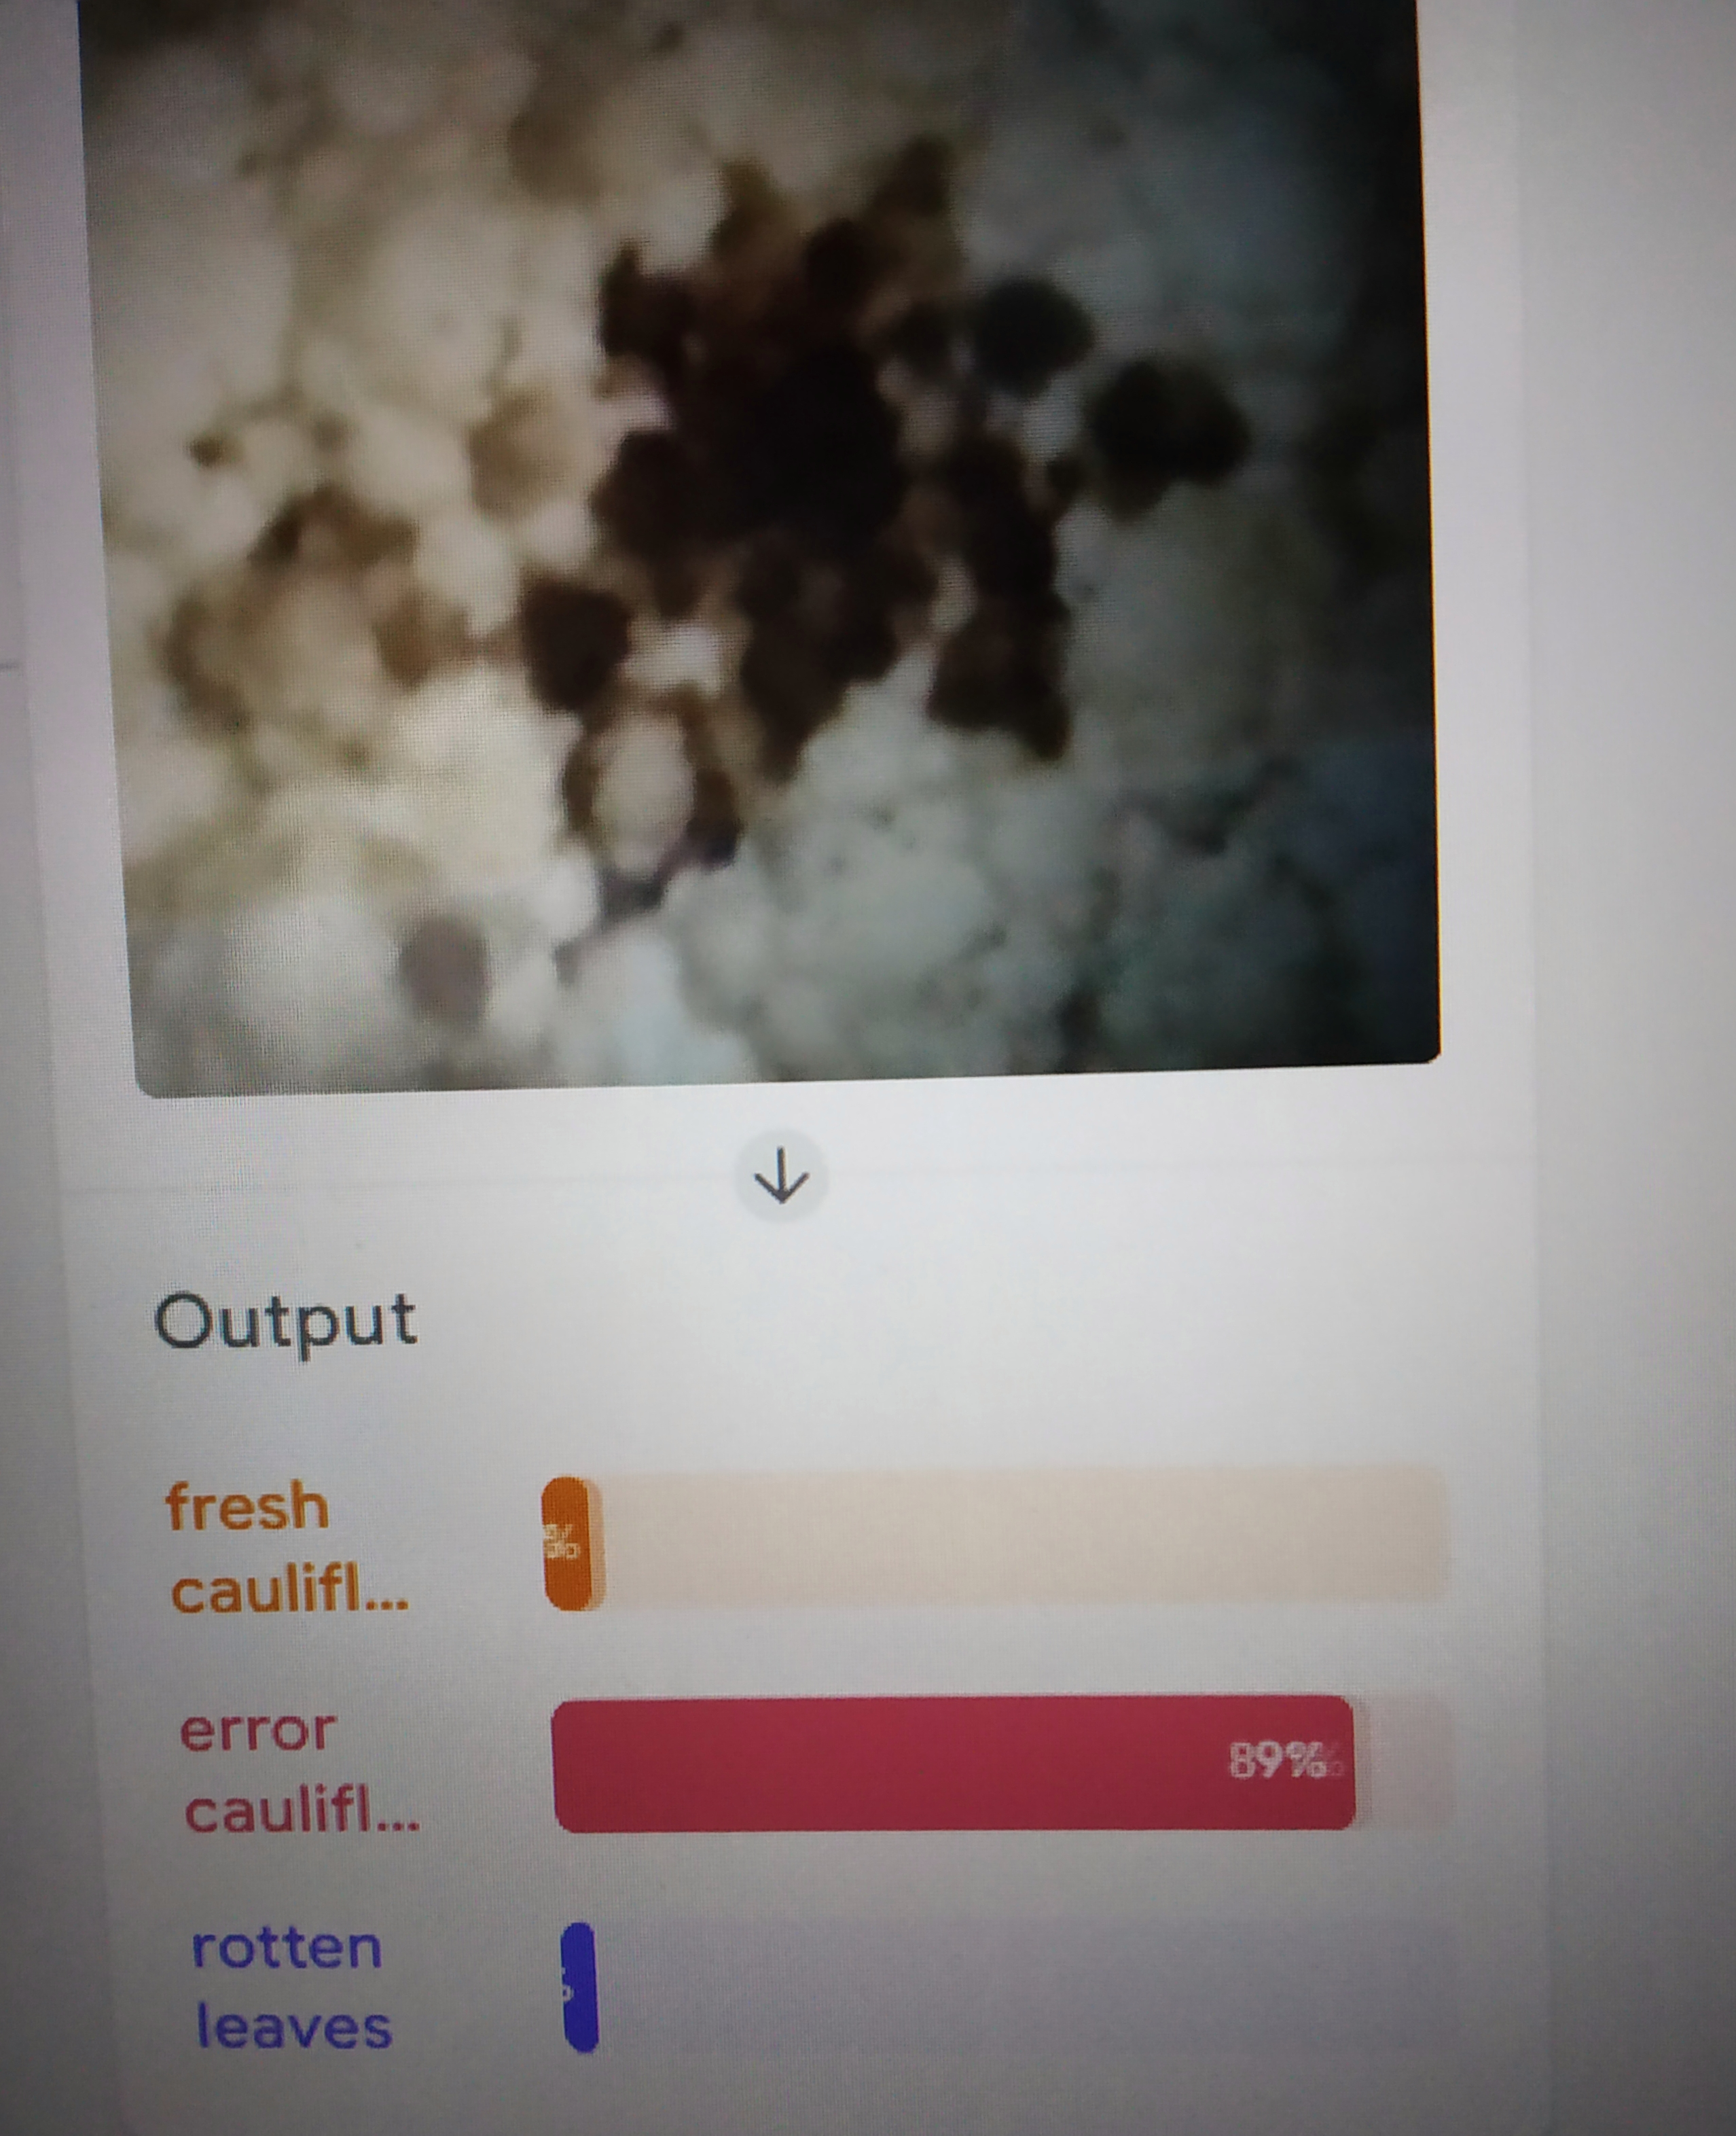
OUTPUT
Challenges: Variability in lighting and complex backgrounds occasionally led to misclassifications. These issues were addressed by expanding the training dataset with more diverse examples and refining preprocessing techniques to improve model robustness.

Slide 14
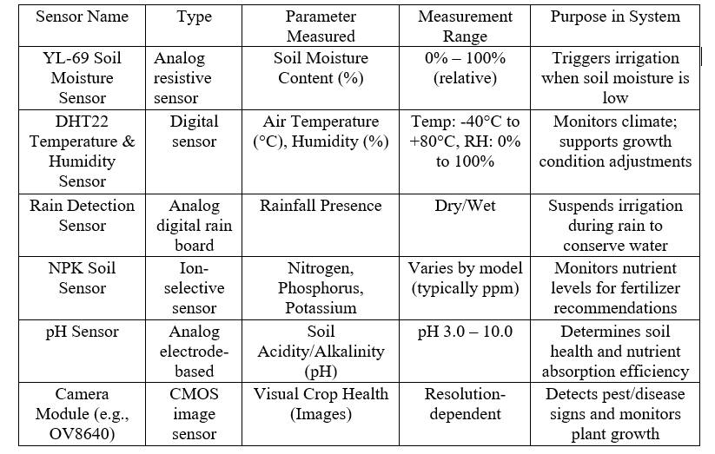
Sensor Specifications and Functionality

Slide 15
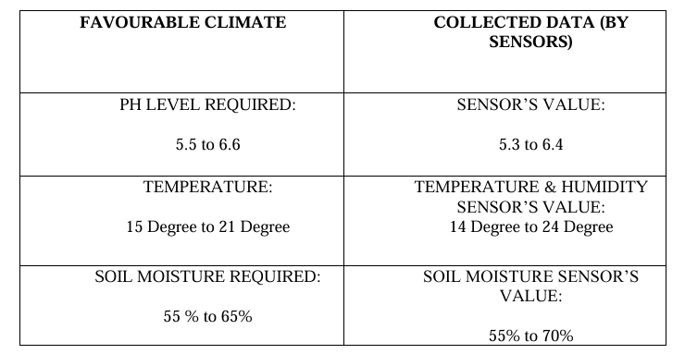
Favourable Climate VS Collected Data
The table compares the favourable climate conditions for cultivation of cauliflower on the other hand the data collected by our sensors.

Slide 16
RESULTS AND DISCUSSION
This subsection reports the testing of the Terratech system, describing the behaviour of both the robotic vehicle and the sensor array, and considers their combined effect on farm produce. The system was tested over the winter cauliflower crop of 2024–2025 at West Bengal, comparing two plots in an experimental farm using Terratech with two control plots on conventional practices.
Robotic Vehicle Performance
The heart of the Terratech system is a specially designed Dual-Mode Controlled Robotic Car, which offers autonomous and manual operation capabilities.
Control and Feedback Design:
In particular, an NRF24L01 system at 2.4 GHz is used for joystick-based remote control over long distances, and an HC-05 Bluetooth system allows for control through a mobile app for operations within a shorter range.
Mechanical Specifications:
Four 300 RPM Johnson motors power the car, with each motor providing 5–10 kg·cm of torque
Operational Modes:
The robot has two different operational modes. In Joystick Mode (NRF24L01), it provides remote directional and angular movement control up to a line-of-sight range of 100 meters.
Movement Capabilities:
The robot is designed with varied movement capabilities. It is capable of executing forward, reverse, left, and right movements, as well as diagonal and angular turns via joystick control
Performance Metrics:
The maximum speed of the robot is around 1.2 m/s when running with full PWM. The control range was tested experientially to around 100 meters using NRF in open terrain and 12 meters using Bluetooth in indoor areas.

Slide 17
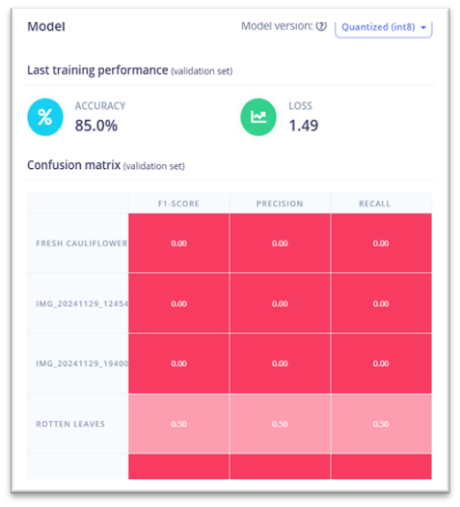
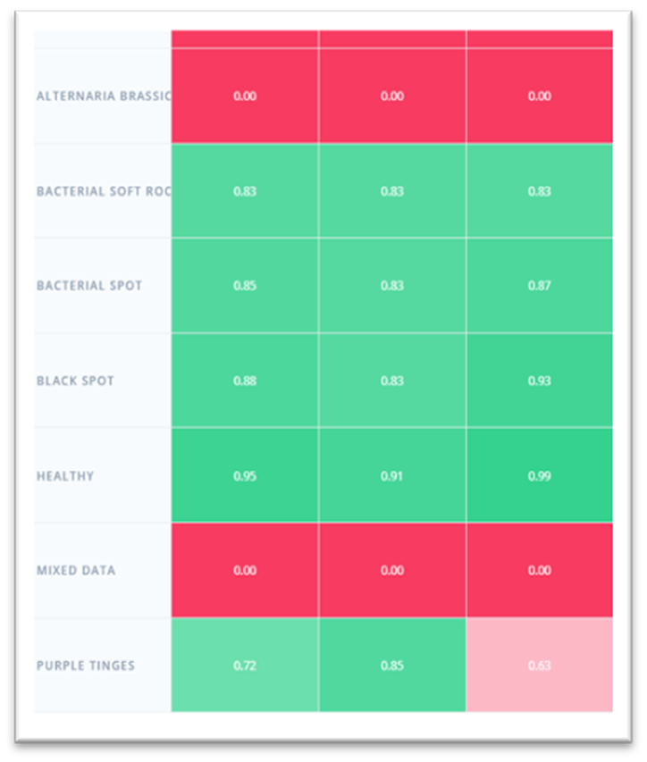
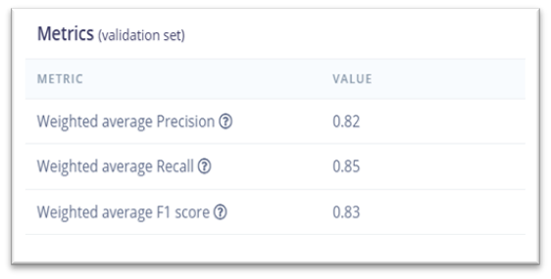
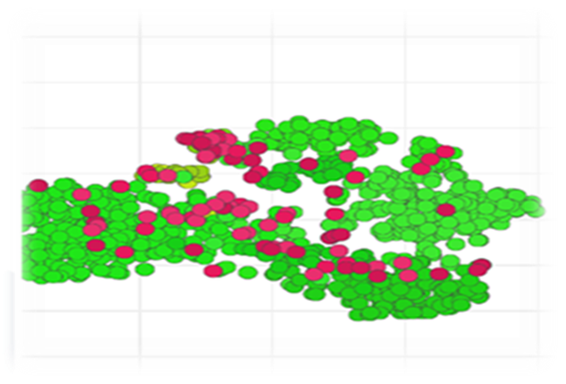
CONFUSION MATRIX
Conclusion: The model is good at detecting Healthy, Black Spot, Bacterial Spot, and Bacterial Soft Rot classes. However, it fails completely on Alternaria Brassicae and Mixed Data, which may indicate:
•Insufficient training data for these classes.
•Ambiguity in features or poor image quality.

Slide 18
REFERENCES
1.Shamshiri, R.R.; Weltzien, C.; Hameed, I.A.; Yule, I.J.; Grift, T.E.; Balasundram, S.K.; Pitonakova, L.; Ahmad, D.; Chowdhary, G. Research and development in agricultural robotics: A perspective of digital farming. International Journal of Agricultural and Biological Engineering, 2018, 11(4), 1-14.
2.Zhu, C. W.; Hill, E.; Biglarbegian, M.; Gadsden, S. A.; & Cline, J. A. Smart agriculture: Development of a skid-steer autonomous robot with advanced model predictive controllers. Robotics and Autonomous Systems, 2023, 162, 104364.
3.Khosravani, A.; Desbiolles, J.M.A.; Fielke, J.M.; Ucgul, M.; Saunders, C. Prediction of Single Disc Seeding System Forces, Using a Semi-Analytical and Discrete Element Method (DEM). Agriculture, 2023, 13, 206.
4.Gondchawar, N., & Kawitkar, R. S. IoT based smart agriculture. International Journal of advanced research in Computer and Communication Engineering, 2016, 5(6), 838-842.
5.Rao, R. N., & Sridhar, B. IoT based smart crop-field monitoring and automation irrigation system. In 2018 2nd International Conference on Inventive Systems and Control (ICISC), 2018, pp. 478-483. ΙΕΕΕ.
6.Sushanth, G., & Sujatha, S. IOT based smart agriculture system. In 2018 International Conference on Wireless Communications, Signal Processing and Networking (WISPNET), 2018, pp. 1-4. IEEE.
7.JETIR. IOT Based Smart Agriculture System, 2021.
8.Lin, J.; Shen, Z.; Zhang, A.; & Chai, Y. Blockchain and IoT based food traceability for smart agriculture. In Proceedings of the 3rd International Conference on Crowd Science and Engineering, 2018, pp. 1-6.
9.Bekmirzaev, G.; Beltrao, J.; Ouddane, B. Effect of Irrigation Water Regimes on Yield of Tetragonia Tetragonioides. Agriculture, 2019, 9, 15.
10.Raghuvanshi, D.; Roy, A.; Panwar, V. IoT Based Smart Agriculture System. International Journal of Research in Engineering and Science, 2021, 9, 12-16.
11.Wang, X.; Zhang, X.; Yang, M.; Gou, X.; Liu, B.; Hao, Y.; Xu, S.; Xue, J.; Qin, X.; Siddique, K.H.M. Multi-Site Evaluation of Accumulated Temperature and Rainfall for Maize Yield and Disease in Loess Plateau. Agriculture, 2021, 11, 373.
12.Dhanaraju, M.; Chenniappan, P.; Ramalingam, K.; Pazhanivelan, S.; Kaliaperumal, R. Smart Farming: Internet of Things (IoT)-Based Sustainable Agriculture. Agriculture, 2022, 12, 1745.
13.Boniecki, P.; Koszela, K.; Świerczyński, K.; Skwarcz, J.; Zaborowicz, M.; Przybył, J. Neural Visual Detection of Grain Weevil (Sitophilus granarius L.). Agriculture, 2020, 10, 20.
14.Treder, W.; Klamkowski, K.; Wójcik, K.; Tryngiel-Gać, A. Machine learning for supporting irrigation decisions based on climatic water balance. Journal of Water and Land Development, 2023, 58 (VII-IX), 25-30.
15.Bradley, J. The Technology Acceptance Model and Other User Acceptance Theories. 2003.

